Slide 1
Student Digital Portfolio
STUDENT NAME: S.AKASH
REGISTER NO AND NMID:2401111058201/asunm1112401111058201
DEPARTMENT:B.SC COMPUTER SCIENCE
COLLEGE:LOGANATHA NARAYANSAMY GOVERMENT COLLEGE/ UNIVERSITY OF MADRAS

Slide 2
PROJECT TITLE
STUDENT DIGITAL PORTFILO
FWD

Slide 3


AGENDA
Problem Statement
Project Overview
End Users
Tools and Technologies
Portfolio design and Layout
Features and Functionality
Results and Screenshots
Conclusion
Github Link
3/21/2024 Annual Review

Slide 4

PROBLEM STATEMENT
Students often face challenges in presenting their skills and achievements in a structured and appealing way. Traditional resumes lack interactivity and design. Hence, there is a need for a simple and attractive student portfolio website that allows students to highlight their details, certificates, and contact information.

Slide 5

PROJECT OVERVIEW
This project is a student portfolio website built using HTML, CSS, and JavaScript. The website showcases the student’s profile, certificates, and contact details in a clean and user-friendly design. The main objective is to provide a professional platform for self-representation.

Slide 6

WHO ARE THE END USERS?
1. Students – To display their personal profile and achievements.
2. Teachers/Mentors – To verify student’s certificates and progress.
3. Recruiters/Employers – To access student’s profile and connect directly.

Slide 7

TOOLS AND TECHNIQUES
Frontend: HTML, CSS, JavaScript
Editor: VS Code / Sublime Text / Notepad++
Browser: Chrome, Edge, Firefox (for execution and testing)

Slide 8
POTFOLIO DESIGN AND LAYOUT
1. About Me Section: Personal introduction and background.
2. Certificates Section: Display of achievements and certifications.
3. Contact Section: Email, phone, or other social links for communication.
8

Slide 9
FEATURES AND FUNCTIONALITY
Simple and responsive design
Interactive navigation with smooth transitions
Certificate showcase with images/details
Contact section for easy communication
Clean and professional layout built only with HTML, CSS, and JavaScript

Slide 10
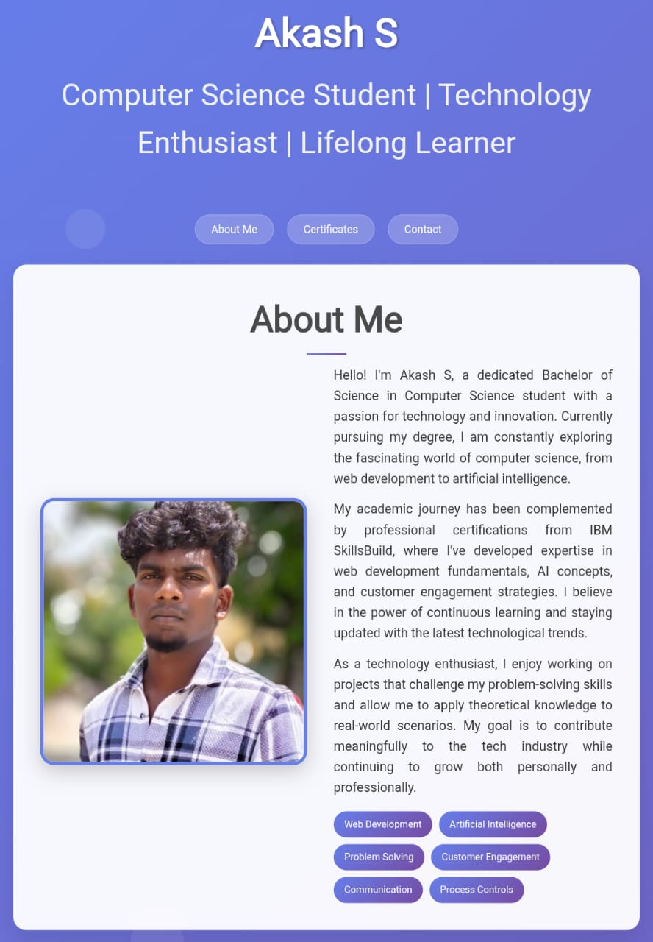
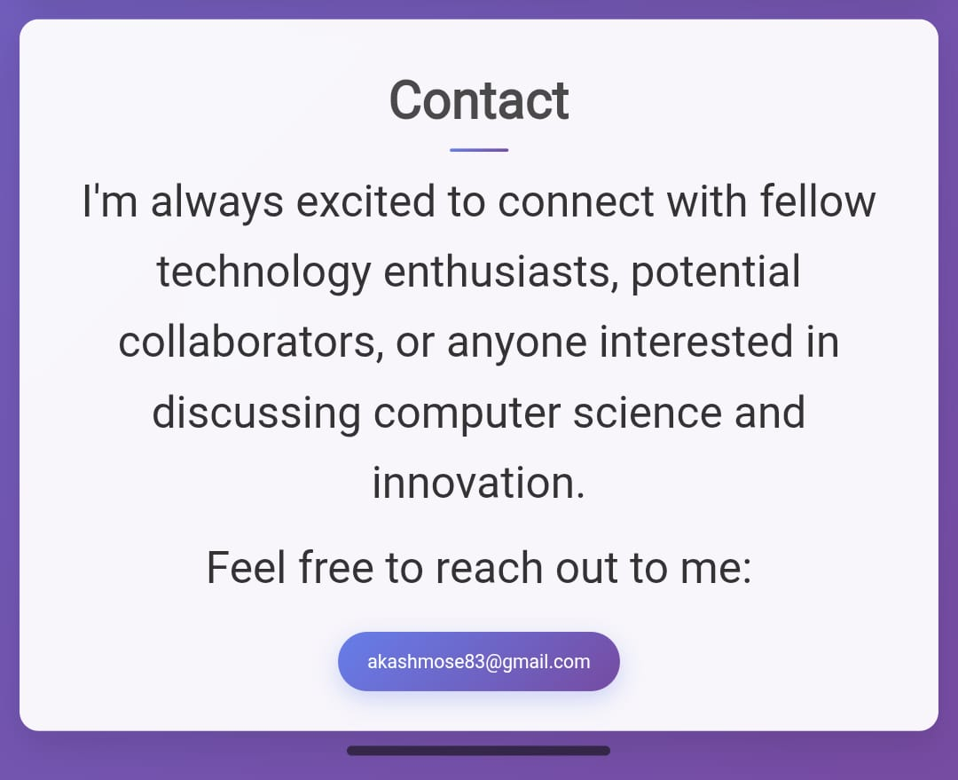
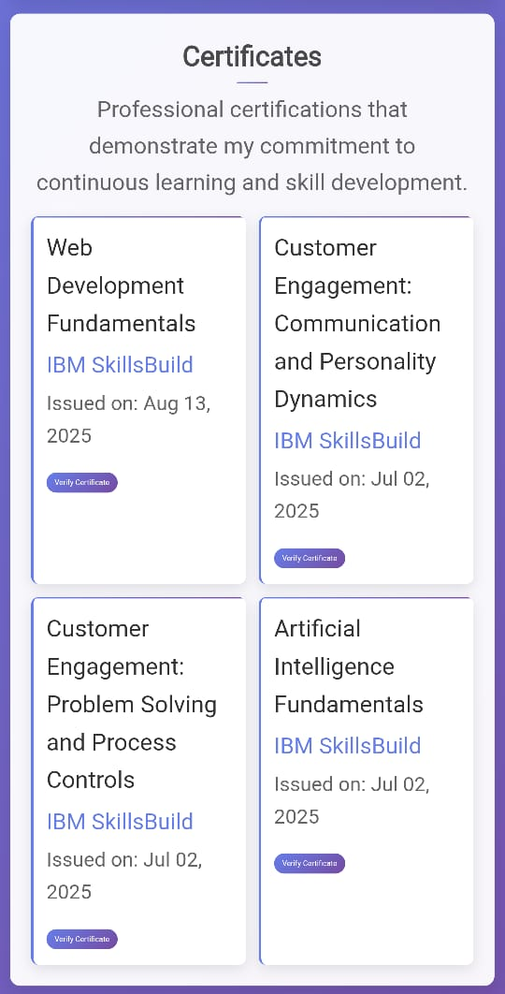
RESULTS AND SCREENSHOTS
10

Slide 11
CONCLUSION
This student portfolio project provides a minimal yet effective way to showcase a student’s profile, certificates, and contact information. It demonstrates how even with basic web technologies like HTML, CSS, and JavaScript, a professional and responsive portfolio can be created to enhance self-branding and career opportunities.
11

